Slide 1
OD Measurements

Slide 2
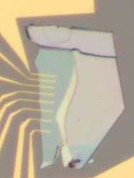
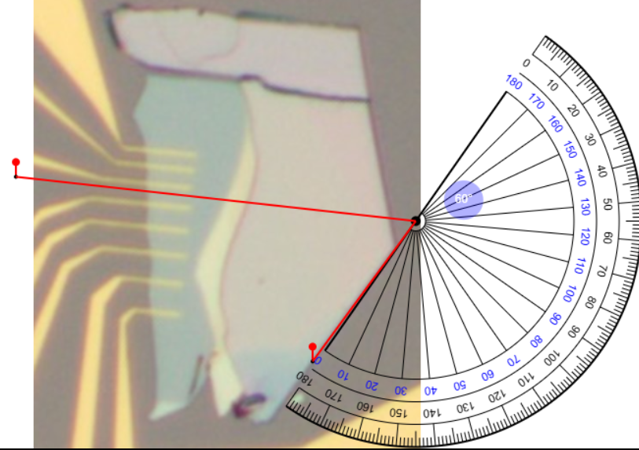
E1
E
135 deg
E2

Slide 3
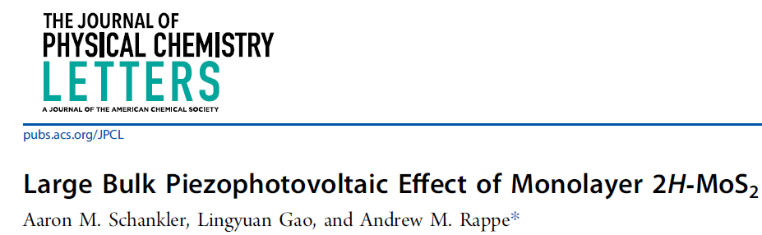
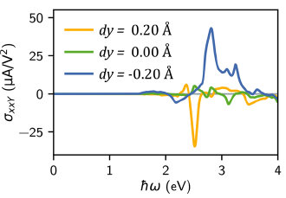
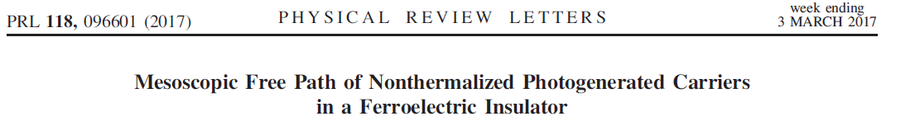
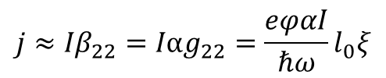
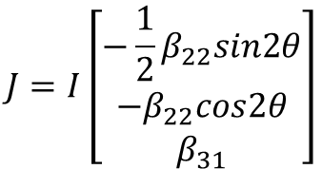
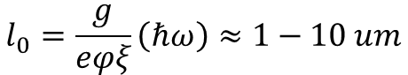
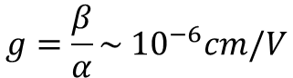
Very Rough Calculation
$$J=I\left[\begin{matrix}{−\frac{1}{2}β}_{22}sin2θ \\ −β_{22}cos2θ \\ β_{31}\end{matrix}\right]$$
Neglect polarization
$${j≈Iβ}_{22}=Iαg_{22}=\frac{eφαI}{ℏω}l_{0}ξ$$
β₂₂ ~ 0.02/V
$$g=\frac{β}{α}\sim {10}^{−6}cm/V$$
α ~ 0.5*10⁵/cm
$$l_{0}=\frac{g}{eφξ}\left(ℏω\right)≈1−10 um$$

Slide 4
Literature: armchair BPVE , no zigzag BPVE

Slide 5
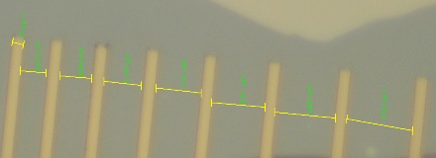
 | Distance (um)
1_2 | 4
1_3 | 11
1_4 | 14
1_5 | 28
1_6 | 38
1_8 | 61
2_3 | 5
2_4 | 13
2_5 | 22
2_6 | 32
2_8 | 55
3_4 | 6
3_5 | 15
3_6 | 25
3_8 | 48
4_5 | 7
4_6 | 17
4_8 | 40
5_6 | 8
5_8 | 31
6_8 | 21
1
2
3
4
5
6
7
8
x
4
5
6
7
8
9
10
Electrode width: 2 um

Slide 6
symmetrical
 |  | Isc
 | Distance (um) | 10 mA (A) | 30 mA (A) | 50 mA (A) | 60 mA (A) | 70 mA (A) | 80 mA
1_2 | 4 | -4.172325e-08 | -4.891367e-08 | -5.181501e-08, -4.717407e-08 | -5.114691e-08 | -5.146123e-08
2_3 | 5 | -1.012199e-10 | -9.438017e-11 | -8.044145e-11 | 1.038774e-10 | 4.166429e-10 | 6.736797e-10
3_4 | 6 | -5.615977e-11 | -4.698851e-11 | -7.210920e-11 | -5.644023e-10 | -1.042813e-09 | -1.701184e-09
4_5 | 7 | 1.180674e-10 | 1.274778e-10 | 3.593753e-10 | 8.641631e-09 | 1.490299e-08 | 2.150201e-08
5_6 | 8 | -1.076799e-10 | -7.631213e-11 | -3.168318e-11 | 4.041626e-12 | 2.609445e-11 | -7.274231e-11
 |  | Voc
 | Distance (um) | 10 mA (V) | 30 mA (V) | 50 mA (V) | 60 mA (V) | 70 mA (V) | 80 mA
1_2 | 4 | 4.540458e-05 | 5.491517e-05 | 5.651731e-05, 5.043709e-05 | 5.562972e-05 | 5.490730e-05
2_3 | 5 | 2.447245e-03 | 2.333769e-03 | 2.103293e-03 | -2.591214e-03 | -8.808171e-03 | -1.179937e-02
3_4 | 6 | 1.333043e-03 | 1.086633e-03 | 1.617421e-03 | 1.117637e-02 | 1.817695e-02 | 2.422859e-02
4_5 | 7 | -1.598908e-03 | -1.667191e-03 | -4.724473e-03 | -7.798635e-02 | -1.043472e-01 | -1.207697e-01
5_6 | 8 | 2.039705e-03 | 1.578559e-03 | 5.893595e-04 | -7.045013e-05 | -4.021542e-04 | 1.123149e-03

Slide 7
asymmetrical
 |  |  | Isc
 | L_Distance (um) | R_Distance (um) | 10 mA (A) | 30 mA (A) | 50 mA (A) | 60 mA (A) | 70 mA (A) | 80 mA
1_3 | 2 | 9
1_3 | 9 | 2
 |  |  | Isc
 | L_Distance (um) | R_Distance (um) | 10 mA (A) | 30 mA (A) | 50 mA (A) | 60 mA (A) | 70 mA (A) | 80 mA
1_3 | 2 | 9
1_3 | 9 | 2

Slide 9
Current (mA) | Intensity (uW) | Density (W/cm2) | Density (W/cm2)
10 | 0.117 | 14.89687 | 3.724229
30 | 0.256 | 32.59486 | 8.14874
49 | 1.26 | 160.4278 | 40.10708
49.5 | 1.58 | 201.1714 | 50.293
50 | 4.9-6 | 630.2521 | 157.5635
50.5 | 8 | 1018.589 | 254.6481
51 | 13.5 | 1718.869 | 429.7187
60 | 203 | 25846.7 | 6461.696
70 | 435 | 55385.79 | 13846.49
80 | 672 | 85561.5 | 21390.44
Laser spot size: ~ 1um (< 2um)
3.14159 um2
0.7854 um2

Slide 10
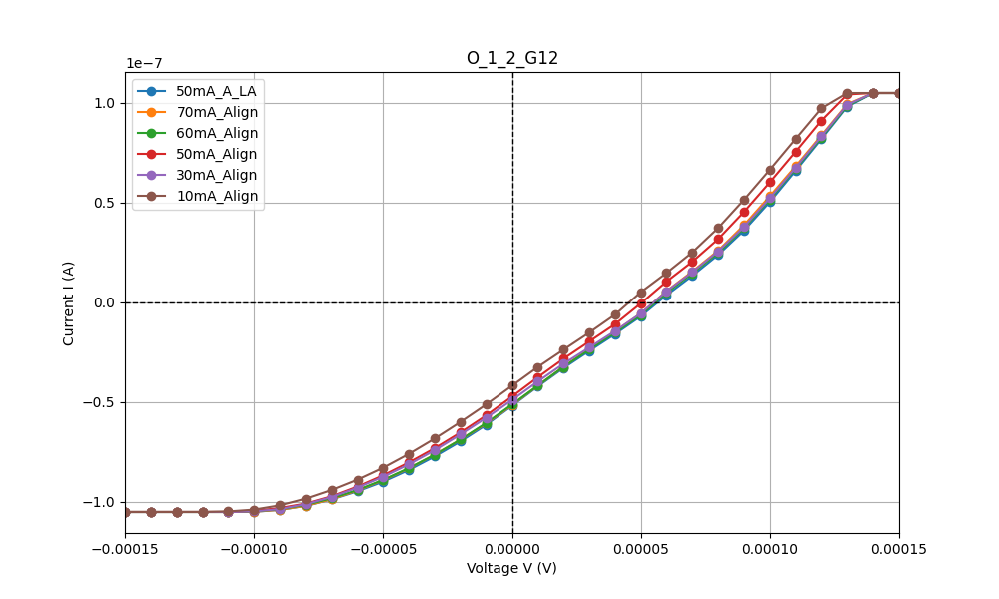
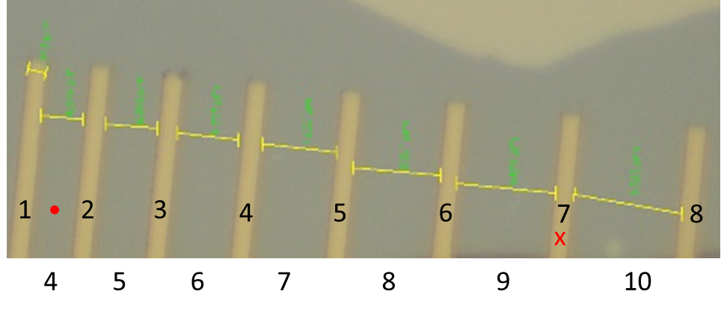
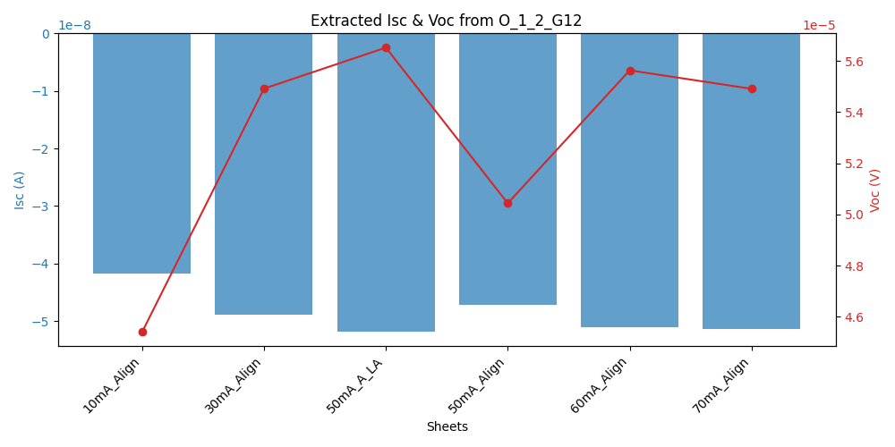
12_G12

Slide 11
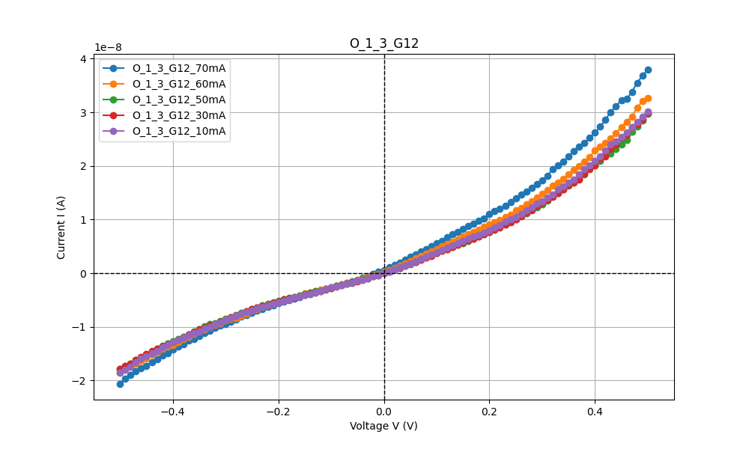
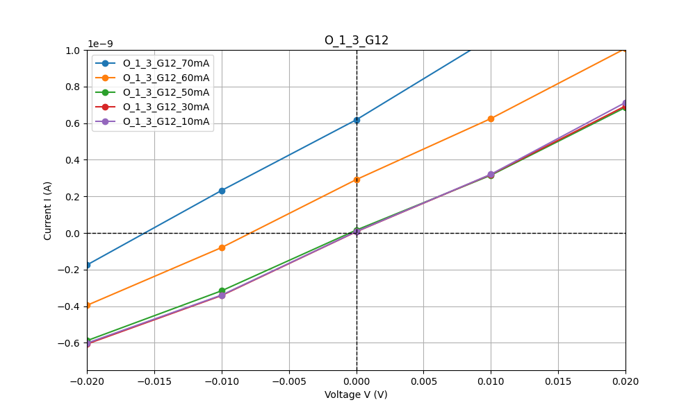
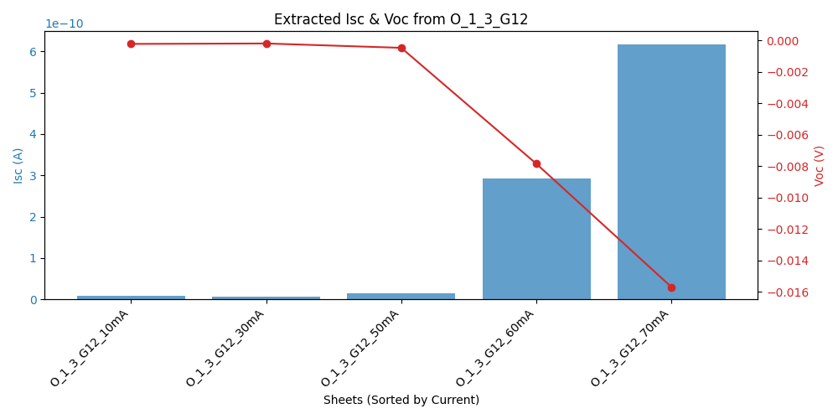
13_G12
Distance between electrodes: 11 um
Left electrode to light: 2 um
Right electrode to light: 9 um

Slide 12
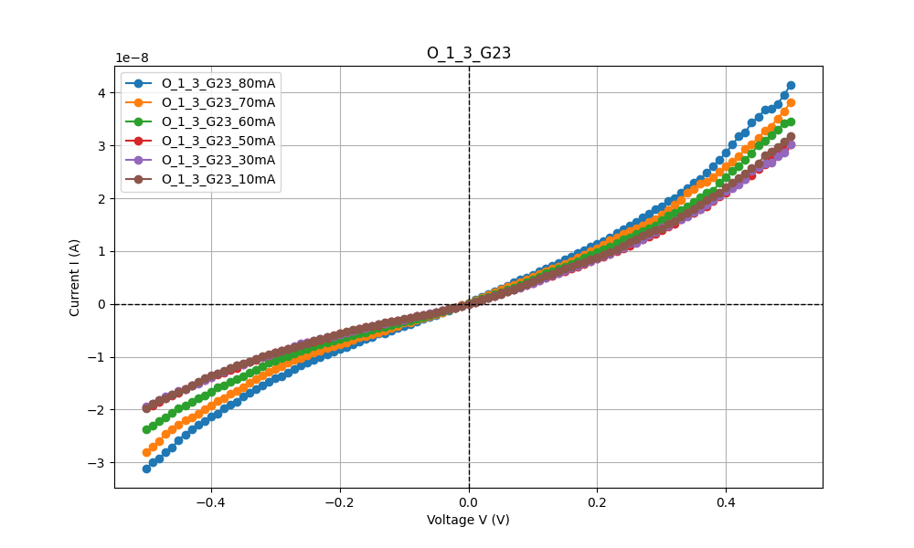

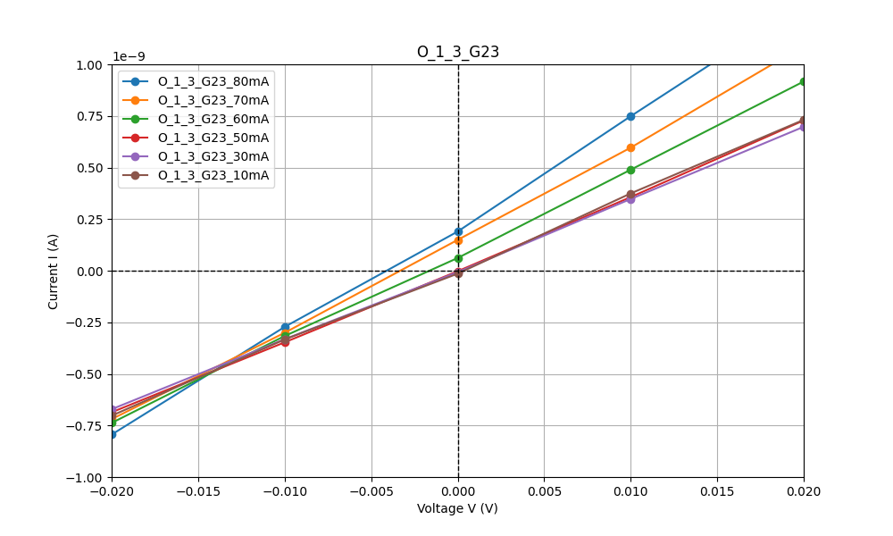
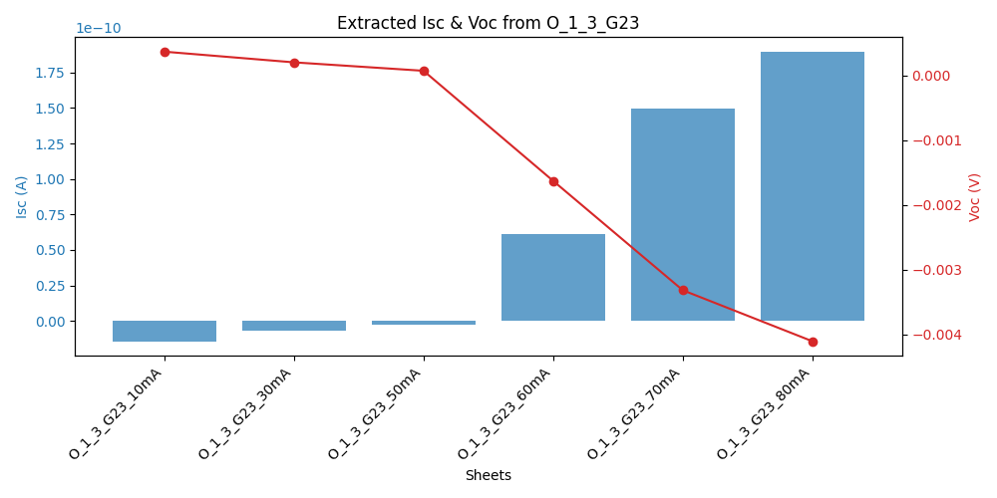
13_G23

Slide 13
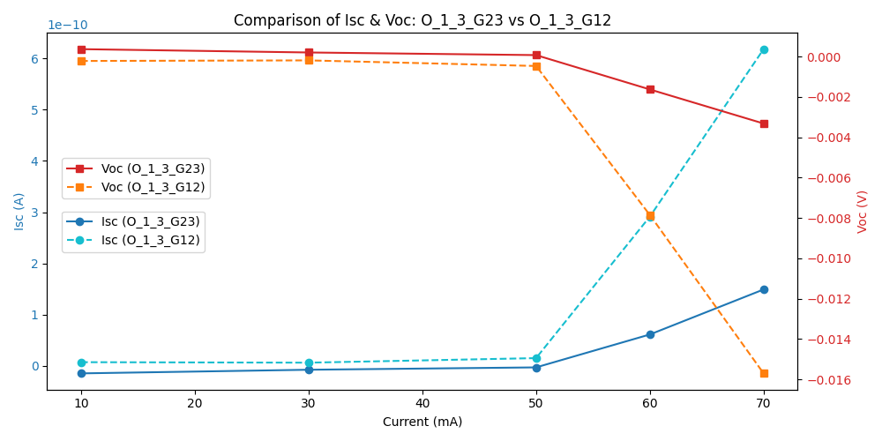
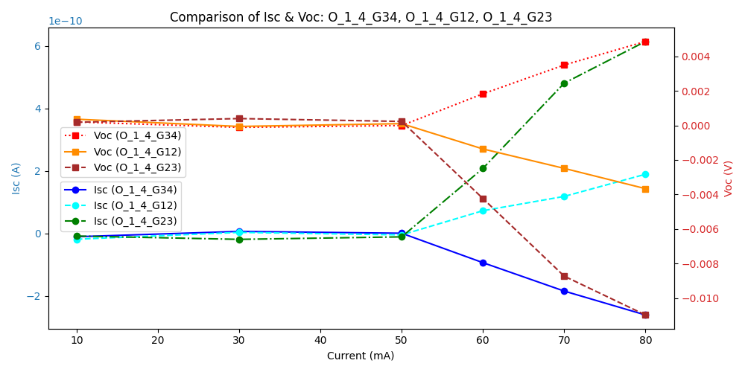

Slide 14
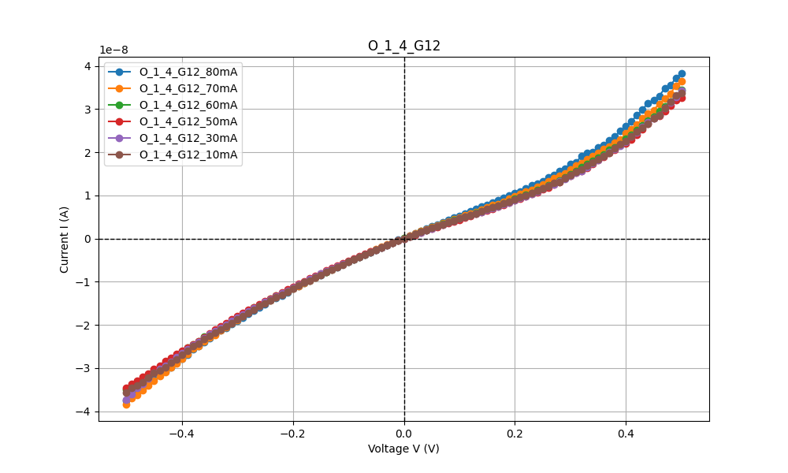
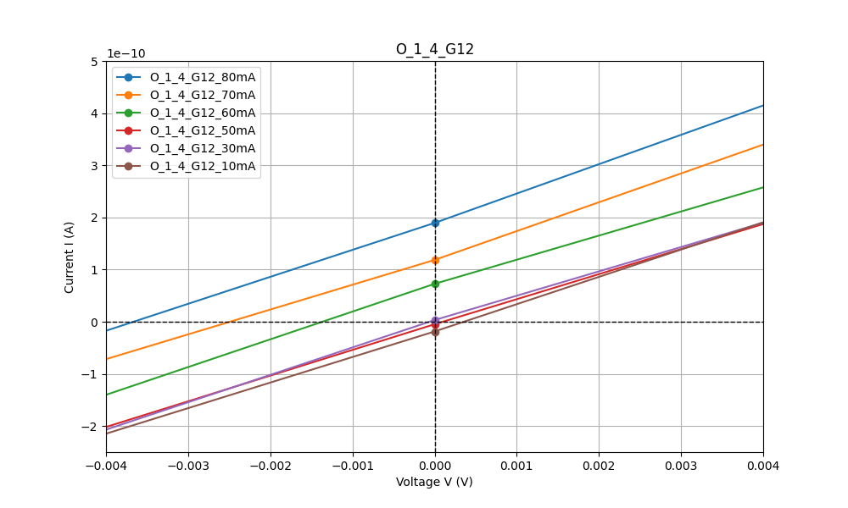
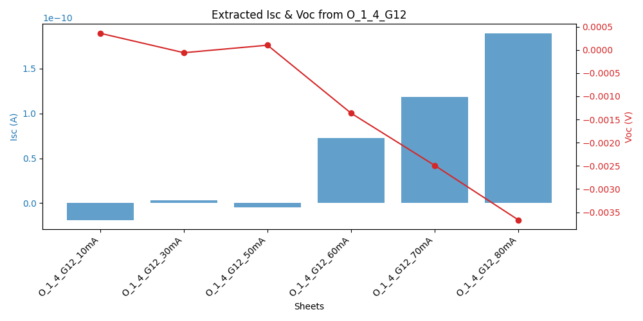
14_G12

Slide 15
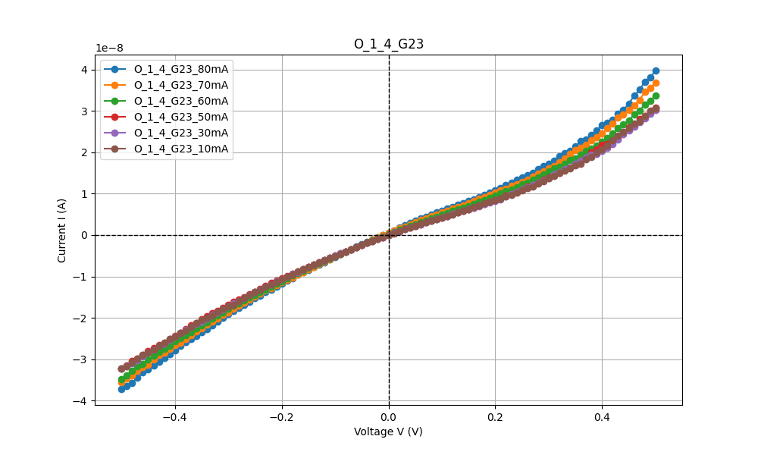
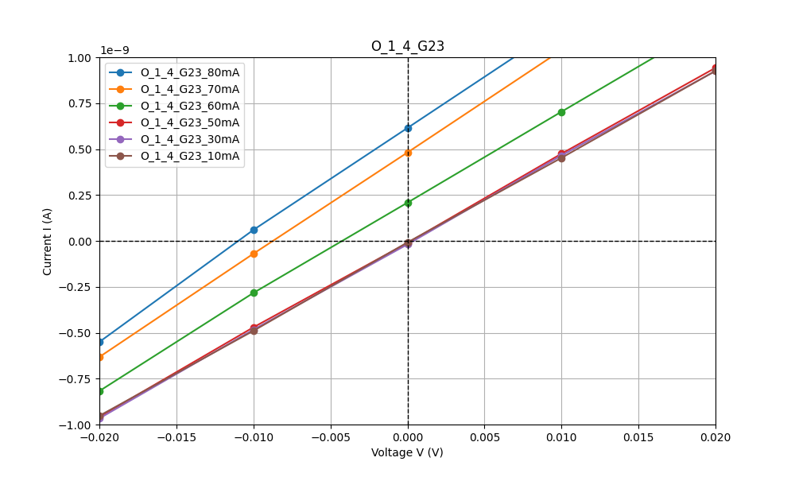
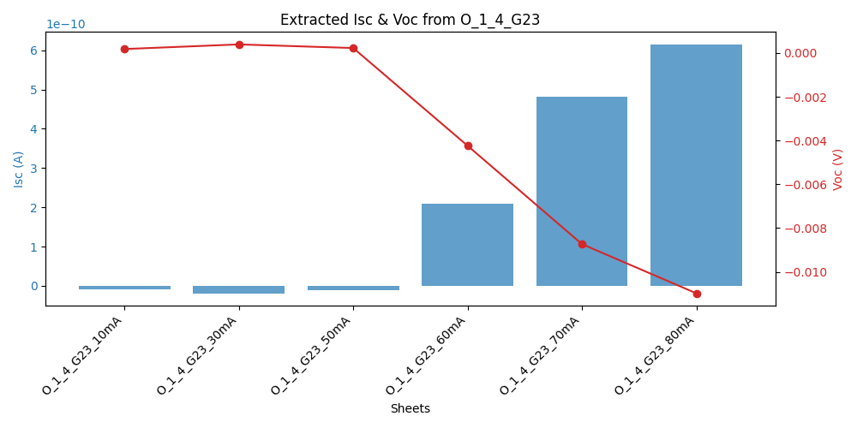
14_G23

Slide 16
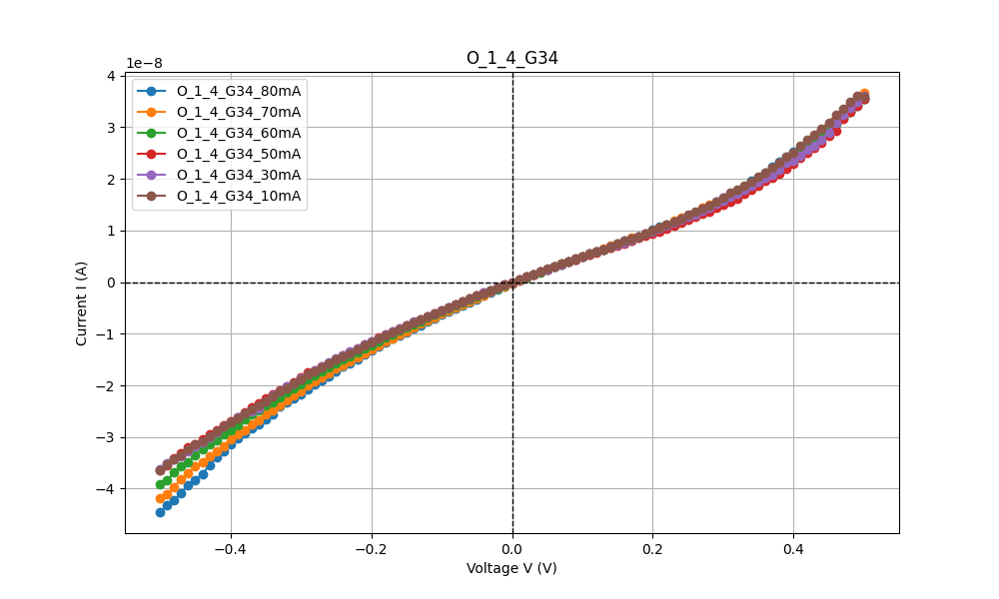

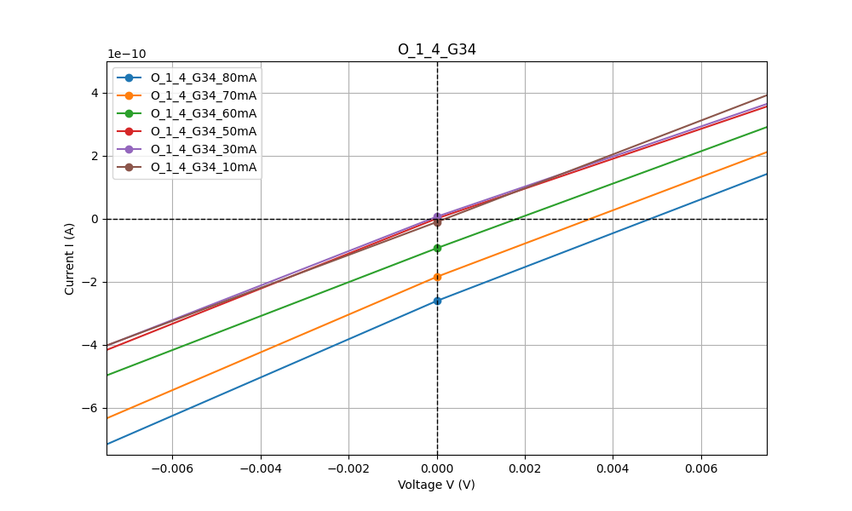
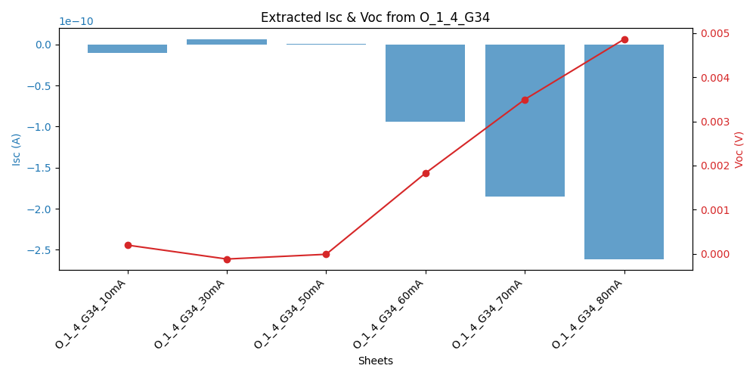
14_G34

Slide 17
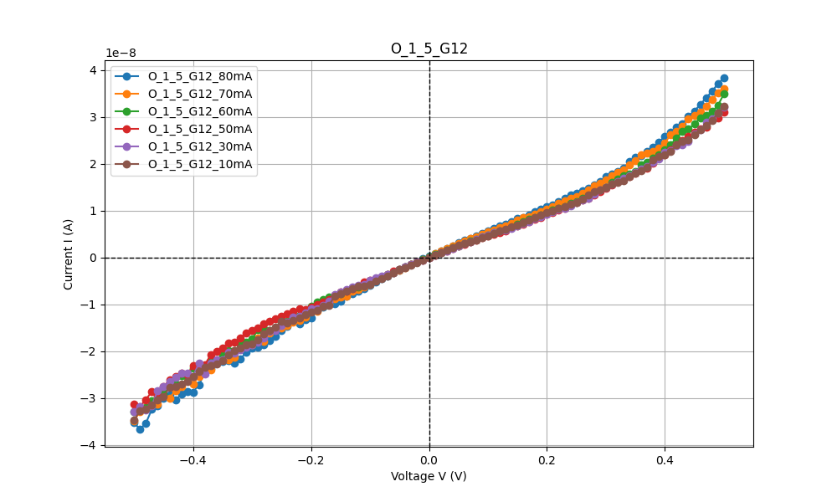
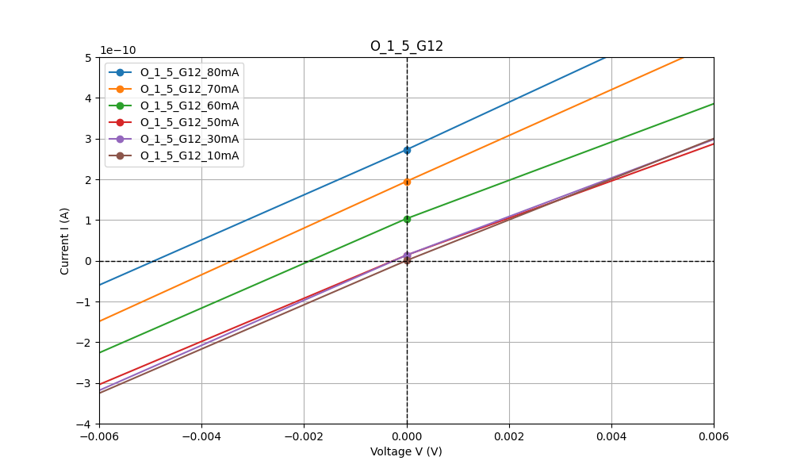
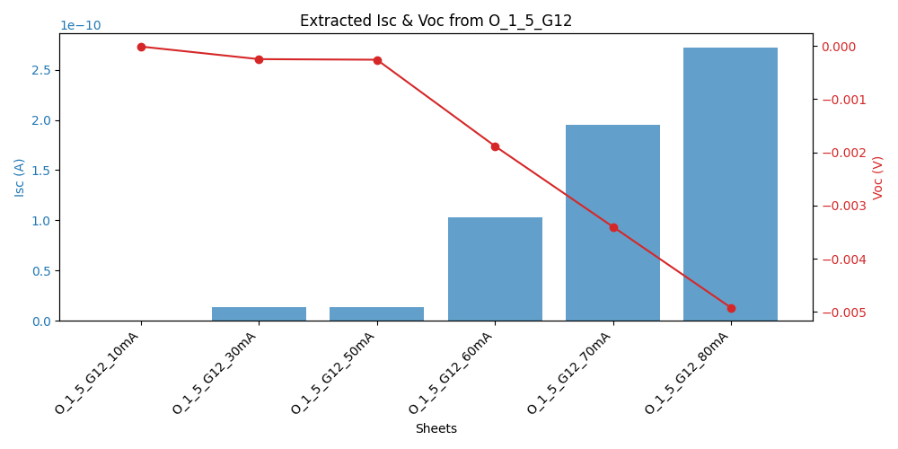
15_G12

Slide 18
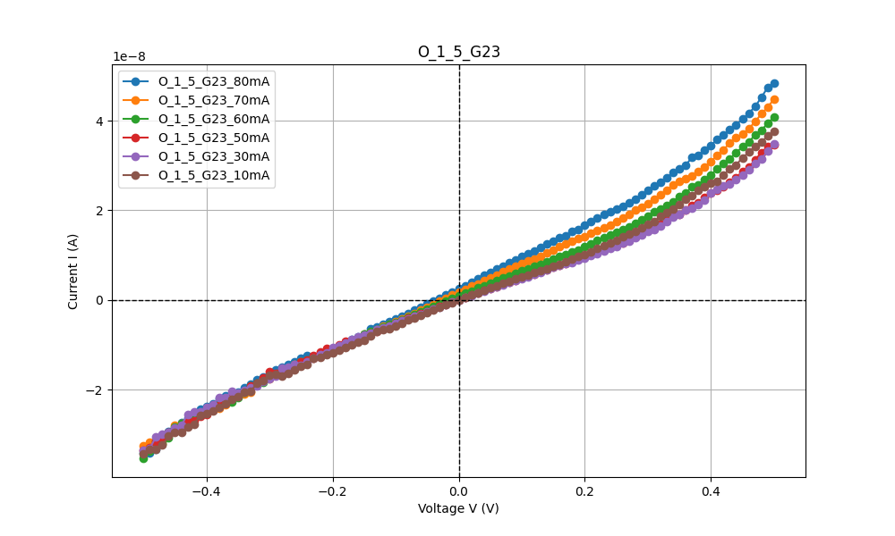
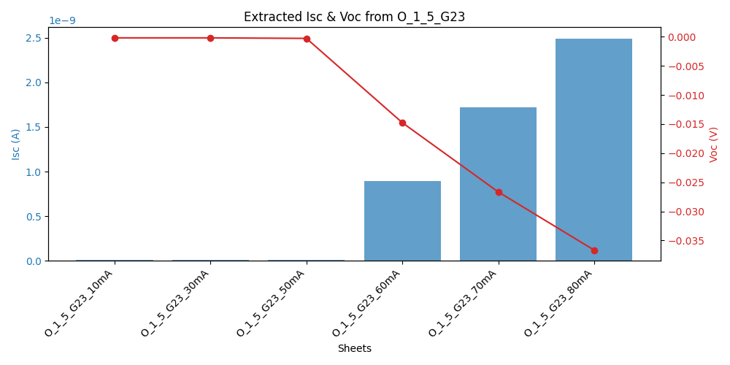
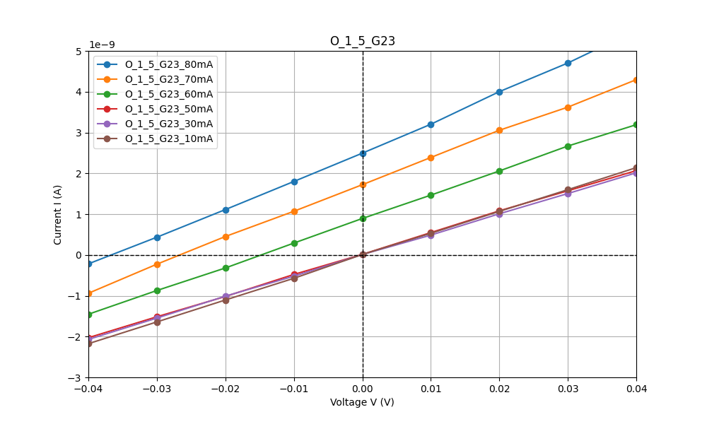
15_G23

Slide 19
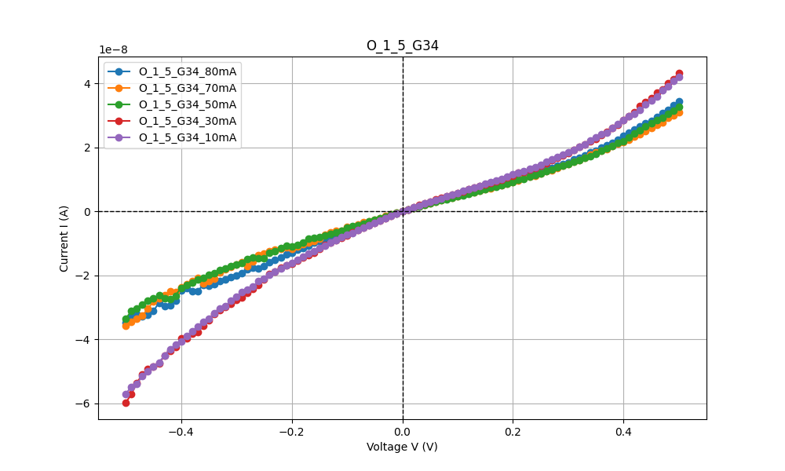
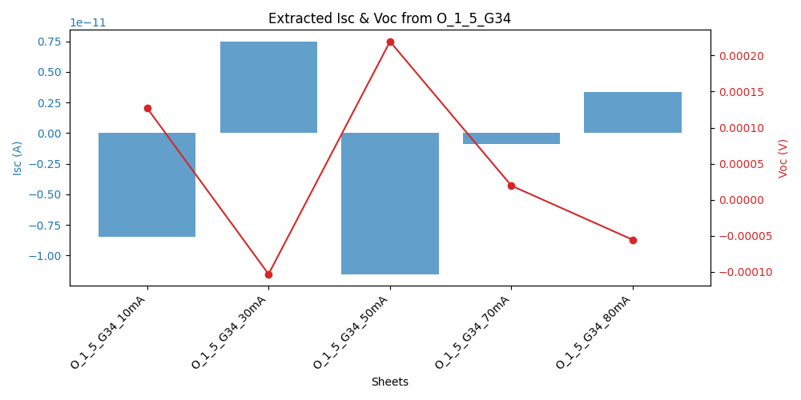
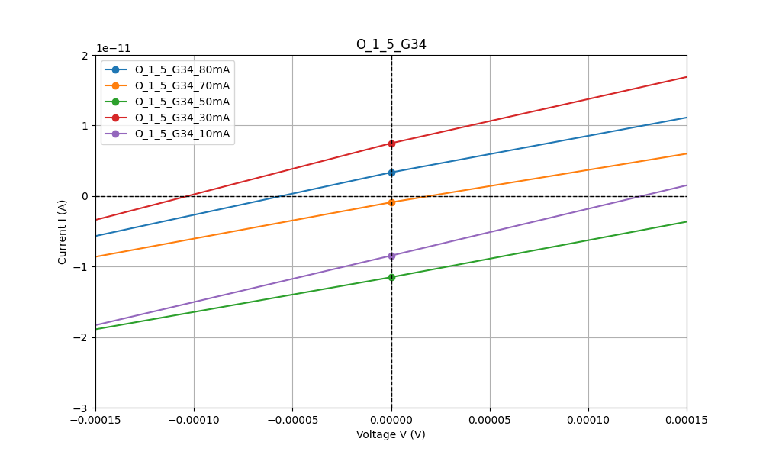
15_G34

Slide 20
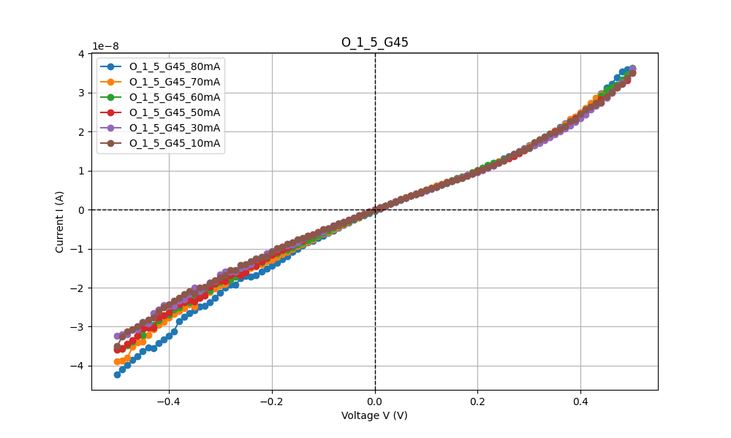

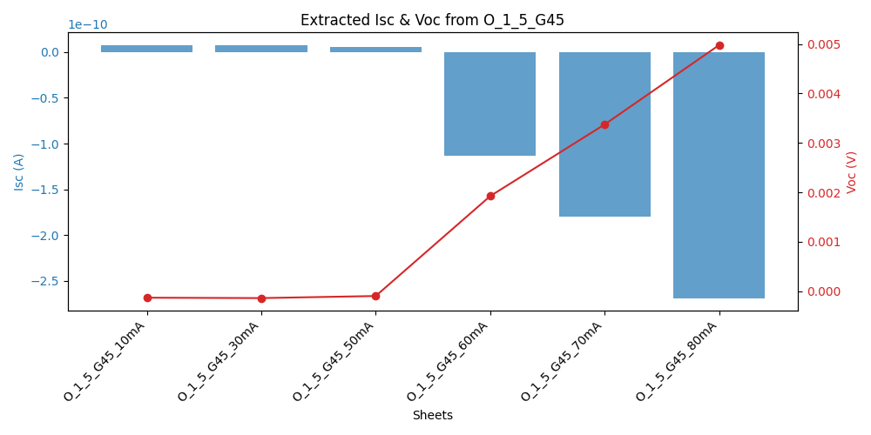
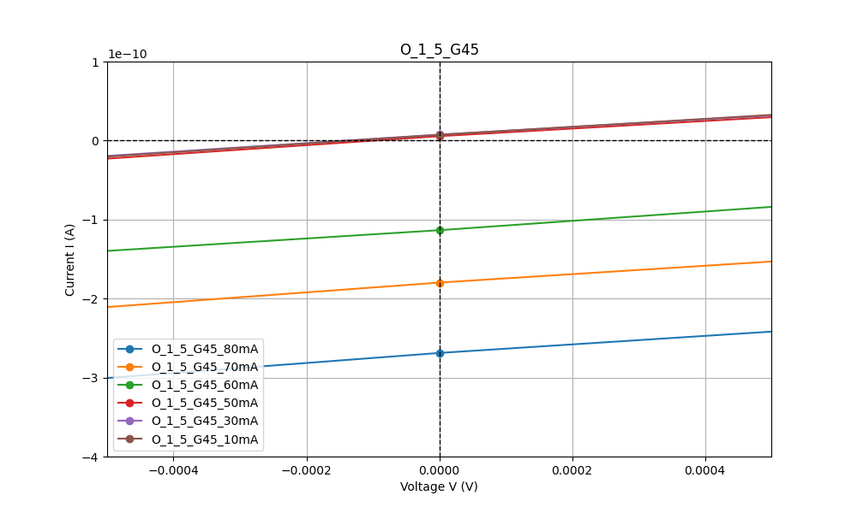
15_G45

Slide 21
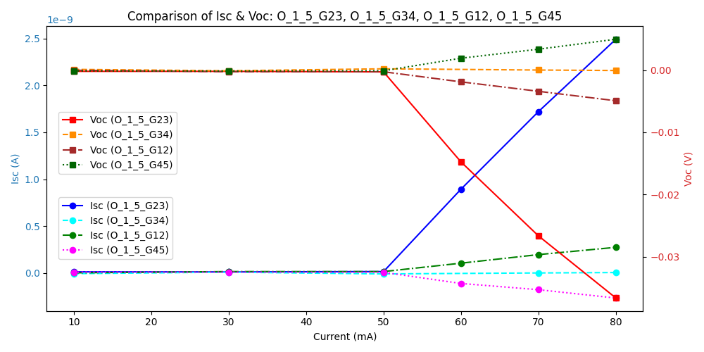
O_1_5

Slide 22
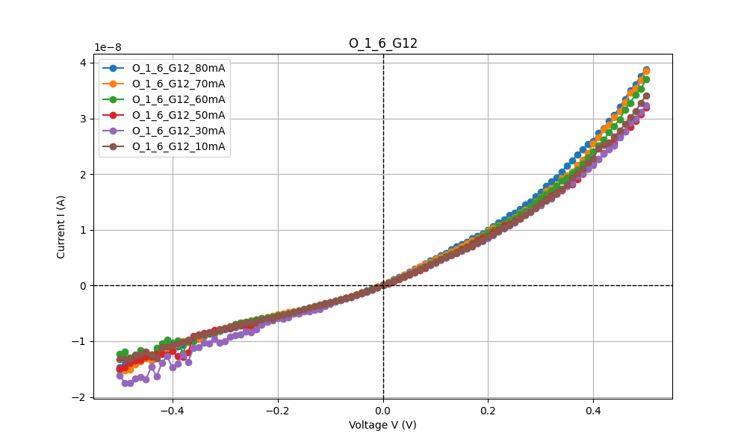
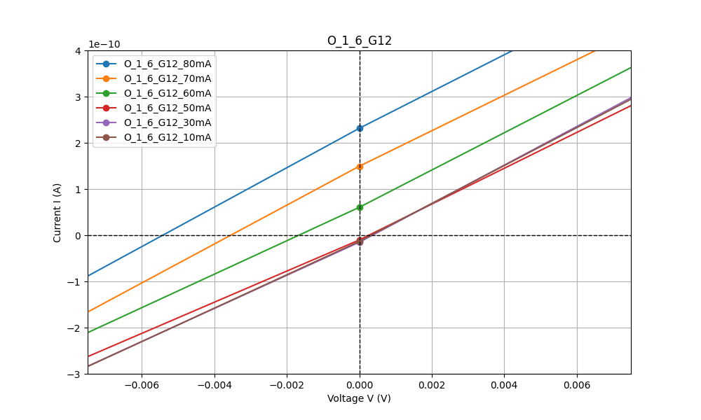
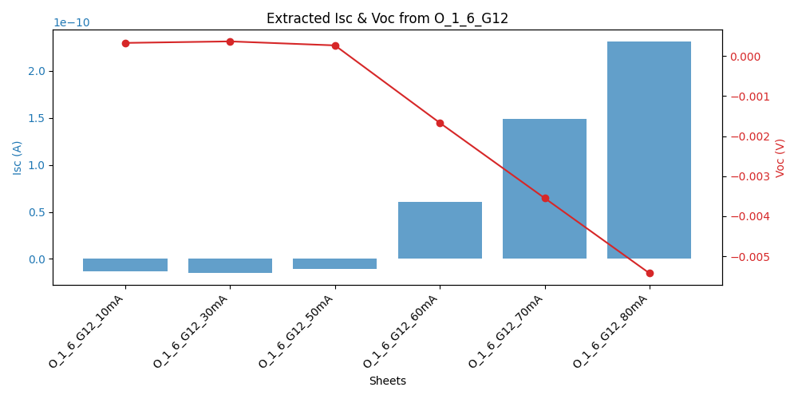
16_G12

Slide 23
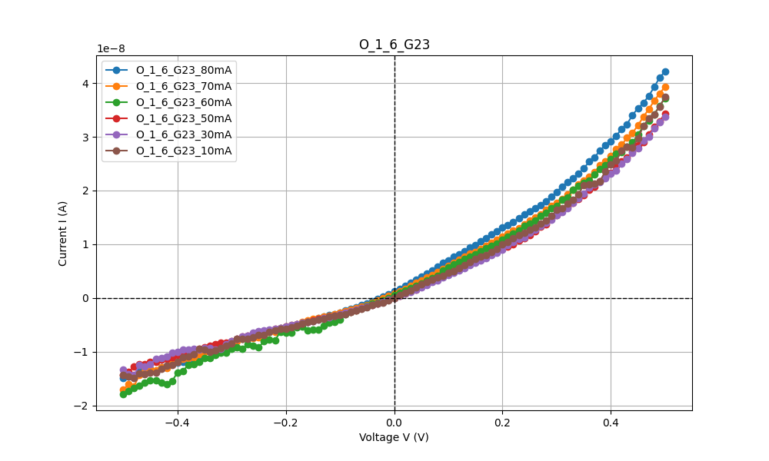
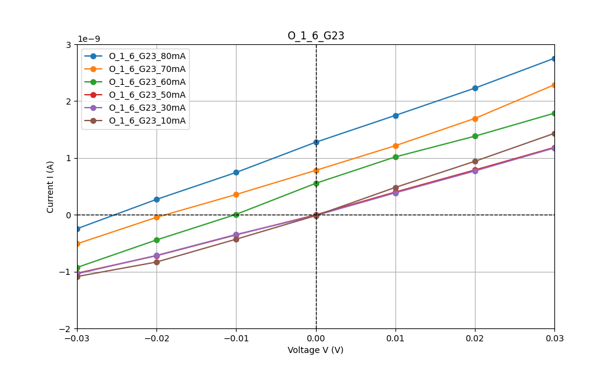
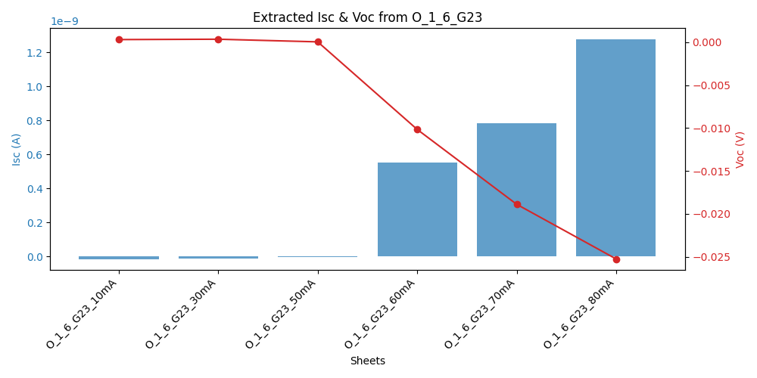
16_G23

Slide 24
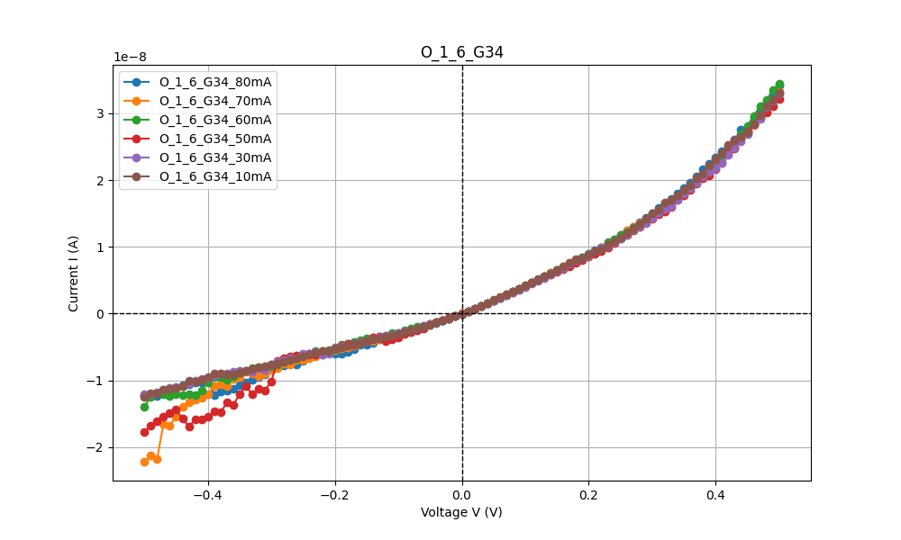


16_G34

Slide 25



16_G45

Slide 26




16_G56

Slide 27


Slide 28



18_G12

Slide 29



18_G23

Slide 30



18_G34

Slide 31



18_G45

Slide 32



18_G56

Slide 33




18_G67

Slide 34




18_G78

Slide 35


Slide 36



23_G23

Slide 37



24_G23

Slide 38



24_G34

Slide 39


Slide 40



25_G23

Slide 41



25_G34

Slide 42



25_G45

Slide 43


Slide 44



26_G23

Slide 45



26_G34

Slide 46



26_G45

Slide 47



26_G56

Slide 48


Slide 49



28_G23

Slide 50



28_G34

Slide 51



28_G45

Slide 52



28_G56

Slide 53



28_G67

Slide 54



28_G78

Slide 55


Slide 56



34_G34

Slide 57



35_G34

Slide 58



35_G45

Slide 59


Slide 60



36_G34

Slide 61



36_G45

Slide 62



36_G56

Slide 63


Slide 64



38_G34

Slide 65



38_G45

Slide 66



38_G56

Slide 67



38_G67

Slide 68



38_G78

Slide 69


Slide 70



45_G45

Slide 71



46_G45

Slide 72



46_G56

Slide 73


Slide 74



48_G45

Slide 75



48_G56

Slide 76



48_G67

Slide 77



48_G78

Slide 78


Slide 79



56_G56

Slide 80



58_G56

Slide 81



58_G67

Slide 82



58_G78

Slide 83



68_G67

Slide 84



68_G78

Slide 85


